Slide 1


Department Of Computer Science And Engineering
PREDICTION OF STROKE USING ADVANCED
MACHINE LEARNING ALGORITHMS
ADITYA INSTITUTE OF TECHOLOGY AND MANAGEMENT
(An Autonomous Institution)
(Approved by AICTE, Permanently Affiliated to JNTU, Kakinada
and Accredited by NBA & NAAC Recognized by UGC 2, (f) 12(b))
TEKKALI-532201
2019-2023
TEAM MEMBERS
K.VENKATASAI(19A51A05F9)(TL)
K.DIVYA(19A51A05G2)
K.POOJA(19A51A05G4)
S.MANASWINI(19A51A05I2)
PROJECT SUPERVISSOR
Dr. B. Kameswara Rao

Slide 2
CONTEXT
ABSTRACT
INTRODUCTION
LITERATURE SURVEY
OBSERVATIONS OF LITERATURE SURVEY
REQUIREMENTS
PROPOSED SOLUTION
METHODOLOGY USED
PROPOSED MODEL
DATASET INFORMATION
PERFORMANCE MEASURES
AUC-ROC CURVE
CONFUSION MATRIX
ACCURACY VS VARIOUS MODELS
ANAYLSIS AND CONCLUSION
REFERENCES

Slide 3

ABSTRACT
Stroke is one of the death causes and one of the primary causes of severe long-term weakness in the world.
Most of the strokes will occur due to an unexpected obstruction of courses by prompting both the brain and heart . Accurate prediction of stroke is highly valuable for early intervention and treatment.
Therefore , the project mainly aims at predicting the chances of occurrence of stroke using the emerging machine learning techniques.
Objective : The major objective is to develop a machine learning model that could aid in the early detection of stroke and the subsequent mitigation of its severe consequences.
Outcome : As a result,by using advanced machine learning algorithms predicting the stroke that can be used by physicians and patients to prescribe and early detect a potential stroke.

Slide 4
INTRODUCTION
Stroke is the second leading cause of death worldwide and one of the most life threatening disease for persons above 65 years. It injures the brain like “heart attack” which injures the heart.
According to world health organisation(WHO) in every year fifteen million people are suffering from stroke all worldwide.
Every 4 mins someone dies from stroke ,but upto 80%of stroke can be prevented if we identify predict the occurrence of stroke in its early stage.

Slide 5
Stroke is a blood clot or bleed in the brain which make permanent damage that has an effect on mobility , cognition , sight , communication.
Stroke is considered as medical urgent situation and can cause long-term neurological damage , complications and often death.
The stroke risk factors included are age , systolic blood pressure, BMI , cholesterol , diabetes , smoking status and intensity , physical activity , alcohol drinking , past history and family history.
The early prediction of stroke is necessary and shall be treated to prevent permanent damage or death..

Slide 6

LITERATURE SURVEY
S.no | Year | Methodology Used | Dataset used | Performance metrics | Result | Reference
1] | 2021 | NAVIE BAYES | Healthcare | Accuracy | 82% | [1]
2] | 2021 | Gradient Boosting | Healthcare | Accuracy | 93% | [2]
3] | 2021 | LoR | Health care | Accuracy | 92% | [3]
4] | 2020 | Weighted Voting | Health-care -stroke-dataset | Accuracy | 94% | [4]
5] | 2019 | Random Forest | Health-care | Accuracy | 93% | [5]

Slide 7
OBSERVATIONS FROM LITERATURE SURVEY
In order to get required knowledge about various concepts related to the present analysis existing literature were studied
From the above Literature Survey , it is found that:
Predicting the stroke early is the crucial task . The early prediction of stroke is necessary and shall be treated to prevent permanent damage or death.
Focusing on predicting clinical outcomes of stroke, excluding studies predicting the occurrence of stroke
The use of ML for predicting stroke outcomes is increasing.

Slide 8
REQUIREMENTS
HARDWARE REQUIREMENTS:
I5 PROCESSOR
16 GB RAM
SOFTWARE REQUIREMENTS :
ANACONDA
JUPITER NOTEBOOK
MS-OFFICE

Slide 9
PROPOSED SOLUTION
We are going to propose solution in this project by using advanced machine learning techniques to predict the stroke.
Different advanced machine learning algorithms we applied on the health-care dataset , and compared accuracy of different algorithms. We take the best accuracy algorithm.
Several assessments and prediction models with advanced ml techniques are used to show acceptable accuracy in identifying stroke-prone patients.

Slide 10
Methodology used
In this model we proposed XG Boost model.
XG Boost stands for Extreme Gradient Boosting.
XG Boost is an implementation of gradient boosted decision trees designed for speed and performance.
XG Boost dominates structured or tabular datasets on classification and regression predictive modelling problems.
It is a highly flexible and versatile tool that can work through most
regression, classification and ranking problems as well as user-built
objective functions.

Slide 11
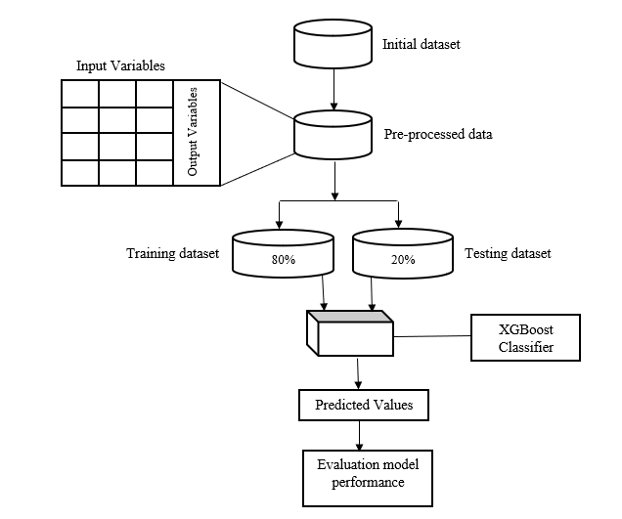
Proposed Model

Slide 12
Dataset Information
This dataset has been collected by kaggle website .
It contains 11 attributes and 5110 instances.
NUMBER OF INSTANCES | 5110
NUMBER OF ATTRRIBUTES | 11
MISSING VALUES | BMI ATTRIBUTE-201

Slide 13
Performance Measure
Accuracy = (TP+TN)/(TP+TN+FP+FN)
Precision = TP/(TP+FP)
Recall = TP/(TP+FN)
F-Measure = 2 x (Precision x Recall)/(Precision + Recall)

Slide 14
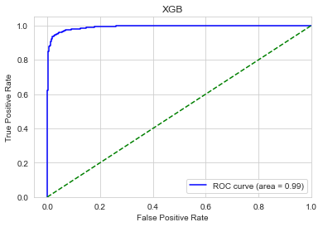
AUC-ROC Curve of XG Boost Model

Slide 15
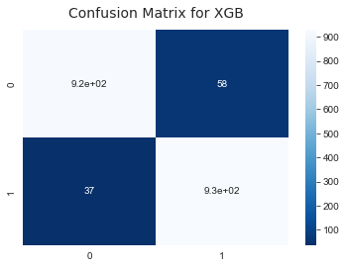
Confusion Matrix of XG Boost Method

Slide 16
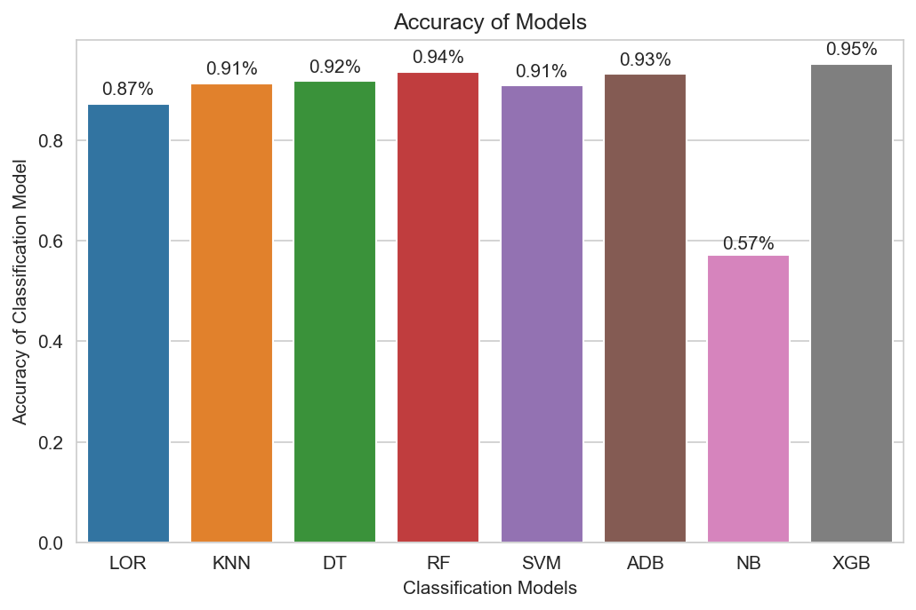
Accuracy vs Various Models

Slide 17
Comparison with Other Models
To compare the proposed ensemble model with the other models.
A comparison study has been done using different standard
Machine Learning models with different performance metrics.
MODEL USED | ACCURACY
GNB | 0.57
LOR | 0.87
KNN | 0.91
SVM | 0.91
DT | 0.92
RF | 0.94
ADB | 0.93
XGB(proposed) | 0.95

Slide 18
Analysis
This analysis describes the simulated results of the XG Boost model
along with other basic Machine Learning algorithms such as
Logistic Regression,Random Forest, Decision Tree,,KNN,Adaboot,GNB.
The results are analyzed in terms of AUC-ROC curve, and Accuracy,
Precision, Recall, F1 Score, F2 Score and AUC-ROC Score.
After the comparative analysis among all the model, it is evident that the
proposed ensembled model XG Boost superseeds over other models
with the accuracy 95%.
The performance of the XG Boost dominates other Machine Learning based models with a Some extent.

Slide 19
Conclusion
In this project ,to Predict stroke at We use Ensemble Model XGBoost For thE the Health-Care-Stroke-Prediction Dataset.
After the Comparative analysis of all the models ,it is evident that Ensemble model XGBoost Accuracy is higher

Slide 20
REFERENCES
[1] Sailasya, Gangavarapu, and Gorli L. Aruna Kumari. &quot;Analyzing the performance of stroke
prediction using ML classification algorithms.&quot; International Journal Of Advanced Computer Science
And Applications 12.6 (2021): 539-545.
[2] Rajora, Maihul, Mansi Rathod, and Nenavath Srinivas Naik. &quot;Stroke Prediction Using Machine
Learning in a Distributed Environment.&quot; International Conference on Distributed Computing and
Internet Technology. Springer, Cham, 2021.
[3] Lip, Gregory YH, et al. "Improving stroke risk prediction in the general population: Common clinical rules, a new multimorbid index and machine learning based algorithms." Thrombosis and haemostasis AAM (2021).
[4] Emon, Minhaz Uddin, et al. &quot;Performance Analysis of Machine Learning Approaches in Stroke
Prediction.&quot; 2020 4th International Conference on Electronics, Communication and Aerospace
Technology (ICECA). IEEE, 2020.
[5] Ali, Abdelmgeid A. &quot;Stroke Prediction using Distributed Machine Learning Based on Apache
Spark.&quot; Stroke 28.15 (2019): 89-97.

Slide 21
THANK YOU !!!

